Slide 1




Musala soft project
Made by ZaFe

Slide 2
Content
1. OUR TEAM
2. OUR GOAL
3. PLANS FOR THE FUTURE
4. FLOW CHART
5. USED TECHNOLOGY

Slide 3

Our TEAM
Plamen Kostov – Scrum Master, Back-End developer
Ilian Yanev – Front-End developer
Kristian Lalev – Quality Engineer

Slide 4


OUR GOALs

Slide 5



Plans for the future

Slide 6
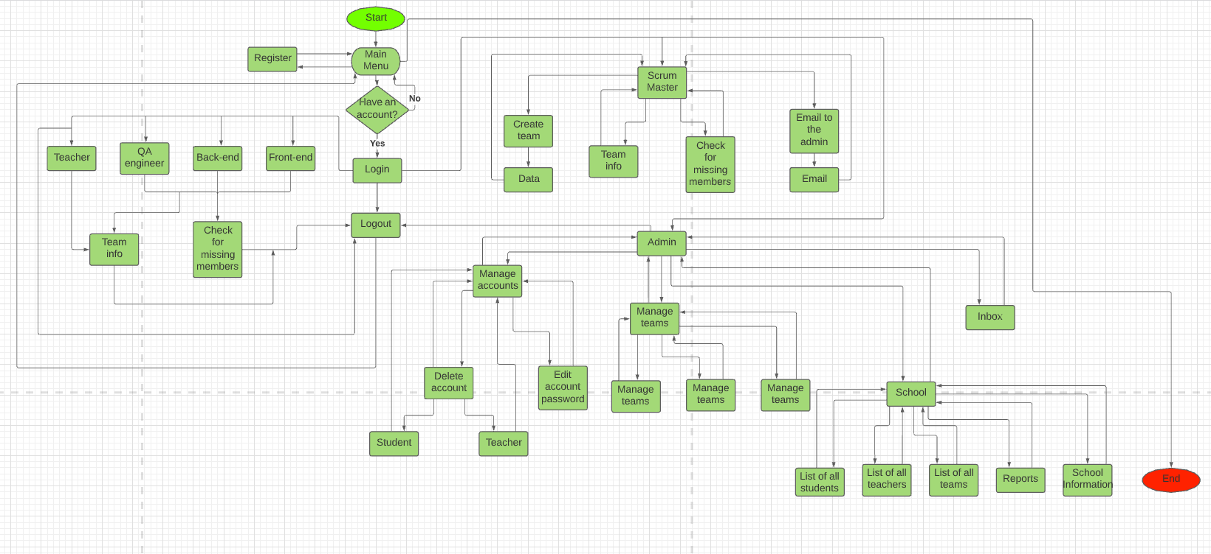
Flow Chart

Slide 7




Used Technology

Slide 8
Thank you for the attention

